Slide 1


http://www.comp.nus.edu.sg/~cs2100/
Lecture #2
Overview of C Programming

Slide 2
Questions?
Ask at https://app.sli.do/event/qVCWNryB45Bnh6p2HRfnFG
OR
Scan and ask your questions here! (May be obscured in some slides)

Slide 3
Lecture #2: Overview of C Programming (1/2)
A Simple C Program
von Neumann Architecture
Variables
Data Types
Program Structure
5.1 Preprocessor Directives
5.2 Input/Output
5.3 Compute
Arithmetic operators
Assignment statements
Typecast operator

Slide 4
Lecture #2: Overview of C Programming (2/2)
Selection Statements
6.1 Condition and Relational Operators
6.2 Truth Values
6.3 Logical Operators
6.4 Evaluation of Boolean Expressions
6.5 Short-Circuit Evaluation
Repetition Statements
7.1 Using ‘break’ in a loop
7.2 Using ‘continue’ in a loop

Slide 5
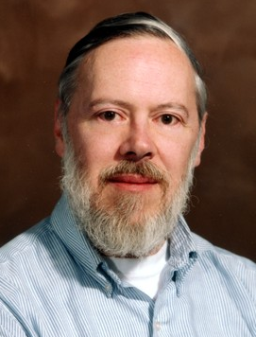
Introduction
C: A general-purpose computer programming language developed in 1972 by Dennis Ritchie (1941 – 2011) at Bell Telephone Lab for use with the UNIX operation System

Slide 6
Quick Review: Edit, Compile, Execute
Compile
Execute
Edit
Source code
Edit
produces
first.c
eg: vim first.c
Executable code
Compile
produces
a.out
Cannot compile?
eg: gcc first.c
Program output
Incorrect result?
Execute
produces
eg: a.out
The value of c is 3.

Slide 7
1. A Simple C Program (1/3)
General form
preprocessor directives
main function header
{
declaration of variables
executable statements
}
“Executable statements” usually consists of 3 parts:
Input data
Computation
Output results

Slide 8
1. A Simple C Program (2/3)
MileToKm.py
MileToKm.c
KMS_PER_MILE = 1.609 # conversion constant
def main():
# Get the distance in miles
miles = float(input("Enter distance in miles: "))
# Convert the distance to km
kms = KMS_PER_MILE * miles
# Display the distance in km
print("That equals", kms, km.");
return 0
if name == "__main__":
main()
// Converts distance in miles to kilometres.
#include <stdio.h> /* printf, scanf definitions */
#define KMS_PER_MILE 1.609 /* conversion constant */
int main(void) {
float miles, // input – distance in miles
kms; // output – distance in kilometres
/* Get the distance in miles */
printf("Enter distance in miles: ");
scanf("%f", &miles);
// Convert the distance to kilometres
kms = KMS_PER_MILE * miles;
// Display the distance in kilometres
printf("That equals %9.2f km.\n", kms);
return 0;
}
Sample run
$ gcc MileToKm.c
$ a.out
Enter distance in miles:
10.5
That equals 16.89 km.
(Note: All C programs in the lectures are available at https://www.comp.nus.edu.sg/~cs2100. Python versions are also available.)

Slide 9
1. A Simple C Program (3/3)
// Converts distance in miles to kilometres.
#include <stdio.h> /* printf, scanf definitions */
#define KMS_PER_MILE 1.609 /* conversion constant */
int main(void) {
float miles, // input – distance in miles
kms; // output – distance in kilometres
/* Get the distance in miles */
printf("Enter distance in miles: ");
scanf("%f", &miles);
// Convert the distance to kilometres
kms = KMS_PER_MILE * miles;
// Display the distance in kilometres
printf("That equals %9.2f km.\n", kms);
return 0;
}
standard header file
preprocessor directives
constant
reserved words
variables
comments
(Only /* … */ is ANSI C)
functions
special symbols
In C, semi-colon (;) terminates a statement.
Curly bracket { } indicates a block.
In Python: block is by indentation

Slide 10
2. von Neumann Architecture (1/2)
What happens in the computer memory?
memory
memory
memory
Executable code of MileToKm.c
Executable code of MileToKm.c
Executable code of MileToKm.c
miles
miles
miles
?
10.5
10.5
kms
kms
kms
?
?
16.89
At the beginning
After user enters: 10.5 to
scanf("%f", &miles);
After this line is executed:
kms = KMS_PER_MILE * miles;
Do not assume that uninitialised variables contain zero! (Very common mistake.)

Slide 11
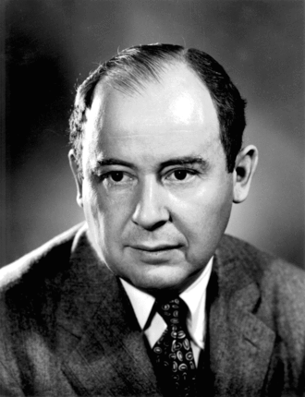
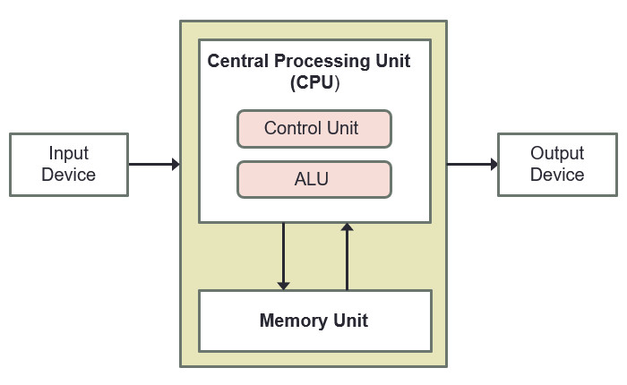
2. von Neumann Architecture (2/2)
John von Neumann (1903 – 1957)
von Neumann architecture* describes a computer consisting of:
Central Processing Unit (CPU)
Registers
A control unit containing an instruction register and program counter
An arithmetic/logic unit (ALU)
Memory
Stores both program and data in random-access memory (RAM)
I/O devices
(* Also called Princeton architecture, or stored-program architecture)

Slide 12
3. Variables
float miles, kms ;
Data used in a program are stored in variables
Every variable is identified by a name (identifier), has a data type, and contains a value which could be modified
(Each variable actually has an address too, but for the moment we will skip this until we discuss pointers.)
A variable is declared with a data type
int count; // variable ‘count’ of type ‘int’
Variables may be initialized during declaration:
int count = 3; // ‘count’ is initialized to 3
Without initialization, the variable contains an unknown value (Cannot assume that it is zero!)
Python
Declaration via assignment in function/global
count = 3

Slide 13
3. Variables: Mistakes in Initialization
InitVariable.c
No initialization
int main(void) {
int count;
count = count + 12;
return 0;
}
Python
-Wall option turns on all warnings
Cannot declare without initialization
$ gcc –Wall InitVariable.c
InitVariable.c: In function 'main':
InitVariable.c:3:8: warning: 'count' is used uninitialized in this function
count = count + 12;
^
Redundant initialization
int count = 0;
count = 123;
int count = 0;
scanf("%d", &count);

Slide 14
4. Data Types (1/3)
float miles, kms;
Every variable must be declared with a data type
To determine the type of data the variable may hold
Basic data types in C:
int: For integers
4 bytes (in sunfire); -2,147,483,648 (-2³¹) through +2,147,483,647 (2³¹ – 1)
float or double: For real numbers
4 bytes for float and 8 bytes for double (in sunfire)
Eg: 12.34, 0.0056, 213.0
May use scientific notation; eg: 1.5e-2 and 15.0E-3 both refer to 0.015; 12e+4 and 1.2E+5 both refer to 120000.0
char: For characters
Enclosed in a pair of single quotes
Eg: 'A', 'z', '2', '*', ' ', '\n’
Python
JS
int
number
Python
JS
float
number
Python
JS
str
string

Slide 15
4. Data Types (2/3)
A programming language can be strongly typed or weakly typed
Strongly typed: every variable to be declared with a data type. (C: int count; char grade; )
Weakly typed: the type depends on how the variable is used (JavaScript: var count; var grade;)
The above is just a simple explanation.
Much subtleties and many views and even different definitions. Other aspects include static/dynamic type checking, safe type checking, type conversions, etc.
Eg: Java, Pascal and C are strongly typed languages. But Java /Pascal are more strongly typed than C, as C supports implicit type conversions and allows pointer values to be explicitly cast.
One fun video: https://www.youtube.com/watch?v=bQdzwJWYZRU

Slide 16
4. Data Types (3/3)
DataTypes.c
// This program checks the memory size
// of each of the basic data types
#include <stdio.h>
int main(void) {
printf("Size of 'int' (in bytes): %d\n", sizeof(int));
printf("Size of 'float' (in bytes): %d\n", sizeof(float));
printf("Size of 'double' (in bytes): %d\n", sizeof(double));
printf("Size of 'char' (in bytes): %d\n", sizeof(char));
return 0;
}
Python
Use sys.getsizeof
import sys
sys.getsizeof(1)
$ gcc DataTypes.c –o DataTypes
$ DataTypes
Size of 'int' (in bytes): 4
Size of 'float' (in bytes): 4
Size of 'double' (in bytes): 8
Size of 'char' (in bytes): 1
-o option specifies name of executable file (default is ‘a.out’)

Slide 17
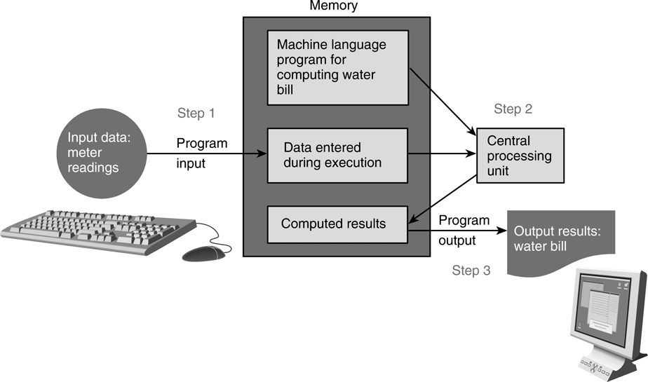
5. Program Structure
A basic C program has 4 main parts:
Preprocessor directives:
eg: #include <stdio.h>, #include <math.h>, #define PI 3.142
Input: through stdin (using scanf), or file input
Compute: through arithmetic operations and assignment statements
Output: through stdout (using printf), or file output

Slide 18
Preprocessor
Input
Compute
Output
5.1 Preprocessor Directives (1/2)
The C preprocessor provides the following
Inclusion of header files
Macro expansions
Conditional compilation
We will focus on inclusion of header files and simple application of macro expansions (defining constants)
Inclusion of header files
To use input/output functions such as scanf() and printf(), you need to include <stdio.h>: #include <stdio.h>
To use functions from certain libraries, you need to include the respective header file, examples:
To use mathematical functions, #include <math.h> (In sunfire, need to compile with –lm option)
To use string functions, #include <string.h>

Slide 19
Preprocessor
Input
Compute
Output
5.1 Preprocessor Directives (2/2)
Macro expansions
One of the uses is to define a macro for a constant value
Eg: #define PI 3.142 // use all CAP for macro
#define PI 3.142
int main(void) {
...
areaCircle = PI * radius * radius;
volCone = PI * radius * radius * height / 3.0;
}
Preprocessor replaces all instances of PI with 3.142 before passing the program to the compiler.
In Python, there is no parallel, but closest is simply declare global variable
PI = 3.142
areaCircle = PI * radius * radius
volCone = PI * radius * height / 3.0
What the compiler sees:
int main(void) {
...
areaCircle = 3.142 * radius * radius;
volCone = 3.142 * radius * radius * height / 3.0;
}

Slide 20
Preprocessor
Input
Compute
Output
5.2 Input/Output (1/3)
Input/output statements:
age
Address of variable ‘age’ varies each time a program is run.
scanf ( format string, input list );
input ( prompt = None )
printf ( format string );
20
print ( value list )
printf ( format string, print list );
One version:
“age” refers to value in the variable age.
“&age” refers to (address of) the memory cell where the value of age is stored.
age = int(input("What is your age?"))
cap = float(input("What is your CAP?"))
print("You are", age, "years old, and your CAP is", cap);
int age;
double cap; // cumulative average point
printf("What is your age? ");
scanf("%d", &age);
printf("What is your CAP? ");
scanf("%lf", &cap);
printf("You are %d years old, and your CAP is %f\n", age, cap);
InputOutput.py
InputOutput.c
Another version:
int age;
double cap; // cumulative average point
printf("What are your age and CAP? ");
scanf("%d %lf", &age, &cap);
printf("You are %d years old, and your CAP is %f\n", age, cap);
user_input = input("What are your age and CAP?")
age, cap = user_input.split(" ")
age, cap = int(age), float(cap)
print("You are", age, "years old, and your CAP is", cap);
InputOutputV2.py
InputOutputV2.c

Slide 21
Preprocessor
Input
Compute
Output
5.2 Input/Output (2/3)
%d and %lf are examples of format specifiers; they are placeholders for values to be displayed or read
Placeholder | Variable Type | Function Use
%c | char | printf / scanf
%d | int | printf / scanf
%f | float or double | printf
%f | float | scanf
%lf | double | scanf
%e | float or double | printf (for scientific notation)
Python
All inputs are read as string
Examples of format specifiers used in printf():
%5d: to display an integer in a width of 5, right justified
%8.3f: to display a real number (float or double) in a width of 8, with 3 decimal places, right justified
Note: For scanf(), just use the format specifier without indicating width, decimal places, etc.

Slide 22
Preprocessor
Input
Compute
Output
5.2 Input/Output (3/3)
\n is an example of escape sequence
Escape sequences are used in printf() function for certain special effects or to display certain characters properly
These are the more commonly used escape sequences:
Escape sequence | Meaning | Result
\n | New line | Subsequent output will appear on the next line
\t | Horizontal tab | Move to the next tab position on the current line
\" | Double quote | Display a double quote "
%% | Percent | Display a percent character %
Try out TestIO.c and compare with TestIO.py

Slide 23
Preprocessor
Input
Compute
Output
5.3 Compute (1/10)
Computation is through function
So far, we have used one function: int main(void)
main() function: where execution of program begins
A function body has two parts
Declarations statements: tell compiler what type of memory cells needed
Executable statements: describe the processing on the memory cells
Python
int main(void) {
/* declaration statements */
/* executable statements */
return 0;
}
def main():
# statements
return 0
if __name__ == "__main__":
main()

Slide 24
Preprocessor
Input
Compute
Output
5.3 Compute (2/10)
Declaration Statements: To declare use of variables
int count, value;
Data type
Names of variables
User-defined Identifier
Name of a variable or function
May consist of letters (a-z, A-Z), digits (0-9) and underscores (_), but MUST NOT begin with a digit
Case sensitive, i.e. count and Count are two distinct identifiers
Guideline: Usually should begin with lowercase letter
Must not be reserved words (next slide)
Should avoid standard identifiers (next slide)
Eg: Valid identifiers: maxEntries, _X123, this_IS_a_long_name Invalid: 1Letter, double, return, joe’s, ice cream, T*S

Slide 25
Preprocessor
Input
Compute
Output
5.3 Compute (3/10)
Reserved words (or keywords)
Have special meaning in C
Eg: int, void, double, return
Complete list: http://c.ihypress.ca/reserved.html
Cannot be used for user-defined identifiers (names of variables or functions)
Standard identifiers
Names of common functions, such as printf, scanf
Avoid naming your variables/functions with the same name of built-in functions you intend to use

Slide 26
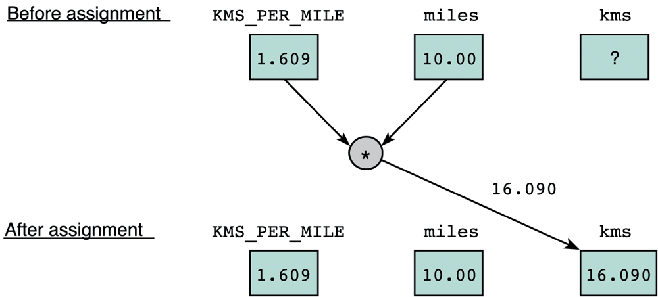
Preprocessor
Input
Compute
Output
5.3 Compute (4/10)
Executable statements
I/O statements (eg: printf, scanf)
Computational and assignment statements
Assignment statements
Store a value or a computational result in a variable
(Note: ‘=’ means ‘assign value on its right to the variable on its left’; it does NOT mean equality)
Left side of ‘=’ is called lvalue
Eg: kms = KMS_PER_MILE * miles;

Slide 27
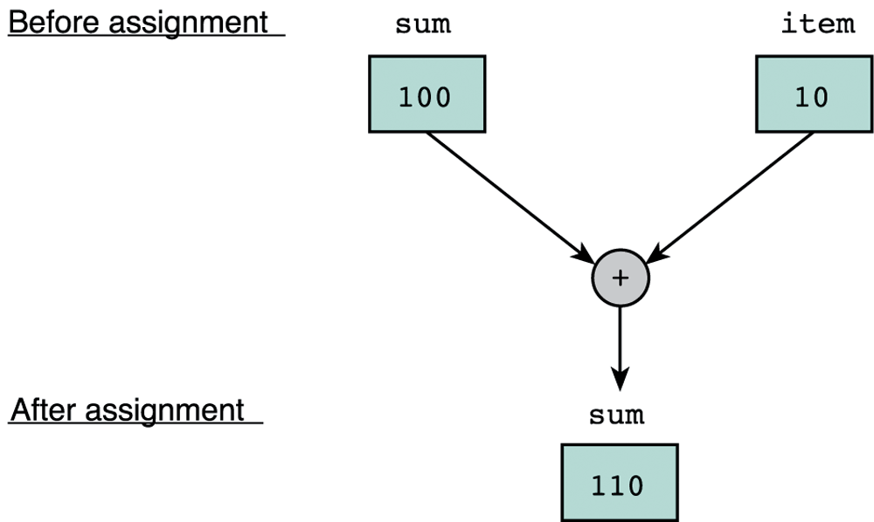
Preprocessor
Input
Compute
Output
5.3 Compute (5/10)
Eg: sum = sum + item;
Note: lvalue must be assignable
Examples of invalid assignment (result in compilation error “lvalue required as left operand of assignment”):
32 = a; // ‘32’ is not a variable
a + b = c; // ‘a + b’ is an expression, not variable
Assignment can be cascaded, with associativity from right to left:
a = b = c = 3 + 6; // 9 assigned to variables c, b and a
The above is equivalent to: a = (b = (c = 3 + 6));
which is also equivalent to:
c = 3 + 6; b = c;
a = b;
Python
Can write: a = b = c = 3 + 6
CANNOT: a = 5 + (b = 3)

Slide 28
Preprocessor
Input
Compute
Output
5.3 Compute (6/10)
Side effect:
An assignment statement does not just assigns, it also has the side effect of returning the value of its right-hand side expression
Hence a = 12; has the side effect of returning the value of 12, besides assigning 12 to a
Usually we don’t make use of its side effect, but sometimes we do, eg:
z = a = 12; // or: z = (a = 12);
The above makes use of the side effect of the assignment statement a = 12; (which returns 12) and assigns it to z
Side effects have their use, but avoid convoluted codes:
a = 5 + (b = 10); // assign 10 to b, and 15 to a
Side effects also apply to expressions involving other operators (eg: logical operators). We will see more of this later.

Slide 29
Preprocessor
Input
Compute
Output
5.3 Compute (7/10)
Arithmetic operations
Binary Operators: +, –, *, /, % (remainder)
Left Associative (from left to right)
46 / 15 / 2 → 3 / 2 → 1
19 % 7 % 3 → 5 % 3 → 2
Unary operators: +, –
Right Associative
x = – 23 p = +4 * 10
Execution from left to right, respecting parentheses rule, and then precedence rule, and then associative rule (slide 30)
addition, subtraction are lower in precedence than multiplication, division, and remainder
Truncate result if result can’t be stored (slide 31)
int n; n = 9 * 0.5; results in 4 being stored in n.

Slide 30
Preprocessor
Input
Compute
Output
5.3 Compute (8/10)
ArithOps.c
// To illustrate some arithmetic operations in C
#include <stdio.h>
int main(void) {
int x, p, n;
// to show left associativity
printf("46 / 15 / 2 = %d\n", 46/15/2);
printf("19 %% 7 %% 3 = %d\n", 19%7%3);
// to show right associativity
x = -23;
p = +4 * 10;
printf("x = %d\n", x);
printf("p = %d\n", p);
// to show truncation of value
n = 9 * 0.5;
printf("n = %d\n", n);
return 0;
}
$ gcc ArithOps.c –o ArithOps
$ ArithOps
46 / 15 / 2 = 1
19 % 7 % 3 = 2
x = -23
p = 40
n = 4

Slide 31
Preprocessor
Input
Compute
Output
5.3 Compute (9/10)
Arithmetic operators: Associativity & Precedence
Operator Type | Operator | Associativity
Primary expression operators | ( ) expr++ expr-- | Left to right
Unary operators | * & + - ++expr --expr (typecast) | Right to left
Binary operators | * / % | Left to right
 | + -
Assignment operators | = += -= *= /= %= | Right to left
Python
expr++, expr--, ++expr, --expr
are not available

Slide 32
Preprocessor
Input
Compute
Output
5.3 Compute (10/10)
Mixed-Type Arithmetic Operations
int m = 10/4; means
float p = 10/4; means
int n = 10/4.0; means
float q = 10/4.0; means
int r = -10/4.0; means
m = 2;
p = 2.0;
n = 2;
q = 2.5;
r = -2;
Caution!
Type Casting
Use a cast operator to change the type of an expression
syntax: (type) expression
int aa = 6; float ff = 15.8;
float pp = (float) aa / 4; means
int nn = (int) ff / aa; means
float qq = (float) (aa / 4); means
pp = 1.5;
nn = 2;
qq = 1.0;
Try out TypeCast.c

Slide 33
5.3 Compute: Difference with Python
Python Floor Division
a = 10/4 means
b = 10//4 means
c = -10/4 means
d = -10//4 means
a = 2.5
b = 2
c = -2.5
d = -3
Modulo
Python % is modulo
a = 10%4 →
b = -10%4 →
C % is remainder
a = 10%4 →
b = -10%4 →
NOTE: be careful with negative values for % operation
a = 2
b = 2
a = 2
b = -2
Try out Modulo.c and compare with Modulo.py

Slide 34
6. Selection Structures (1/2)
C provides two control structures that allow you to select a group of statements to be executed or skipped when certain conditions are met.
if … else …
if (condition) {
/* Execute these statements if TRUE */
}
if condition:
# Statement
if condition:
# Statement
elif condition:
# Statement
else:
# Statement
if (condition) {
/* Execute these statements if TRUE */
}
else {
/* Execute these statements if FALSE */
}

Slide 35
6. Selection Structures (2/2)
switch
Python
No counterpart
/* variable or expression must be of discrete type */
switch ( <variable or expression> ) {
case value1:
Code to execute if <variable or expr> == value1
break;
case value2:
Code to execute if <variable or expr> == value2
break;
...
default:
Code to execute if <variable or expr> does not
equal to the value of any of the cases above
break;
}

Slide 36
6.1 Condition and Relational Operators
A condition is an expression evaluated to true or false.
It is composed of expressions combined with relational operators.
Examples: (a <= 10), (count > max), (value != -9)
Relational Operator | Interpretation
< | is less than
<= | is less than or equal to
> | is greater than
>= | is greater than or equal to
== | is equal to
!= | is not equal to
Python
Allows
1 <= x <= 5

Slide 37
6.2 Truth Values
Python
NOTE: only integers!
In Python and JavaScript you have truthy and falsy values, but not in C
Boolean values: true or false.
There is no Boolean type in ANSI C. Instead, we use integers:
0 to represent false
Any other value to represent true (1 is used as the representative value for true in output)
Example:
TruthValues.c
int a = (2 > 3);
int b = (3 > 2);
printf("a = %d; b = %d\n", a, b);
a = 0; b = 1

Slide 38
6.3 Logical Operators
Complex condition: combining two or more Boolean expressions.
Examples:
If temperature is greater than 40C or blood pressure is greater than 200, go to A&E immediately.
If all the three subject scores (English, Maths and Science) are greater than 85 and mother tongue score is at least 80, recommend taking Higher Mother Tongue.
Logical operators are needed: && (and), || (or), ! (not).
A | B | A && B | A || B | !A
False | False | False | False | True
False | True | False | True | True
True | False | False | True | False
True | True | True | True | False
Python
A || B → A or B
A && B → A and B
!A → not A

Slide 39
6.4 Evaluation of Boolean Expressions (1/2)
The evaluation of a Boolean expression is done according to the precedence and associativity of the operators.
Operator Type | Operator | Associativity
Primary expression operators | ( ) [ ] . -> expr++ expr-- | Left to Right
Unary operators | * & + - ! ~ ++expr --expr (typecast) sizeof | Right to Left
Binary operators | * / % | Left to Right
 | + -
 | < > <= >=
 | == !=
 | &&
 | ||
Ternary operator | ?: | Right to Left
Assignment operators | = += -= *= /= %= | Right to Left
Python
cond ? expr1 : expr2 →
expr1 if cond else cond2

Slide 40
6.4 Evaluation of Boolean Expressions (2/2)
What is the value of x?
int x, y, z,
a = 4, b = -2, c = 0;
x = (a > b || b > c && a == b);
x is true (1)
gcc issues warning (why?)
Always good to add parentheses for readability.
y = ((a > b || b > c) && a == b);
y is false (0)
What is the value of z?
z = ((a > b) && !(b > c));
z is true (1)
Try out EvalBoolean.c

Slide 41
6.5 Short-Circuit Evaluation
Does the following code give an error if variable a is zero?
if ((a != 0) && (b/a > 3)) {
printf(. . .);
}
Short-circuit evaluation
expr1 || expr2: If expr1 is true, skip evaluating expr2 and return true immediately, as the result will always be true.
expr1 && expr2: If expr1 is false, skip evaluating expr2 and return false immediately, as the result will always be false.

Slide 42
7. Repetition Structures (1/2)
C provides three control structures that allow you to select a group of statements to be executed repeatedly.
while ( condition )
{
// loop body
}
do
{
// loop body
} while ( condition );
for ( initialization; condition; update )
{
// loop body
}
Update: change value of loop variable
Initialization: initialize the loop variable
Condition: repeat loop while the condition on loop variable is true

Slide 43
7. Repetition Structures (2/2)
Example: Summing from 1 through 10.
Sum1To10_DoWhile.py
Sum1To10_While.py
Sum1To10_DoWhile.c
Sum1To10_While.c
sum, i = 0, 1
sum = sum + i
i = i + 1
while i <= 10:
sum = sum + i
i = i + 1
sum,i = 0, 1
while i <= 10:
sum = sum + i
i = i + 1
int sum = 0, i = 1;
do {
sum = sum + i;
i++;
}
while (i <= 10);
int sum = 0, i = 1;
while (i <= 10) {
sum = sum + i;
i++;
}
Sum1To10_For.py
Sum1To10_For.c
sum = 0
for i in range(1, 11):
sum = sum + i
int sum, i;
for (sum = 0, i = 1; i <= 10; i++) {
sum = sum + i;
}

Slide 44
7.1 Using ‘break’ in a loop (1/2)
BreakInLoop.py
BreakInLoop.c
Without 'break':
1
Ya
2
Ya
3
Ya
4
Ya
5
Ya
# without 'break'
print("Without 'break':");
for i in range(1,6):
print(i)
print("Ya")
// without 'break'
printf ("Without 'break':\n");
for (i=1; i<=5; i++) {
printf("%d\n", i);
printf("Ya\n");
}
# with 'break'
print("With 'break':");
for i in range(1,6):
print(i)
if i == 3:
break
print("Ya")
}
// with 'break'
printf ("With 'break':\n");
for (i=1; i<=5; i++) {
printf("%d\n", i);
if (i==3)
break;
printf("Ya\n");
}
With 'break':
1
Ya
2
Ya
3

Slide 45
7.1 Using ‘break’ in a loop (2/2)
With 'break’ in …
1, 1
Ya
1, 2
Ya
1, 3
2, 1
Ya
2, 2
Ya
2, 3
3, 1
Ya
3, 2
Ya
3, 3
BreakInLoop.py
BreakInLoop.c
# with 'break' in a nested loop
print("With 'break' in a nested loop:")
for i in range(1,4):
for j in range(1,6):
print(i, ",", j)
if j == 3:
break;
print("Ya")
// with 'break' in a nested loop
printf("With 'break' in a nested loop:\n");
for (i=1; i<=3; i++) {
for (j=1; j<=5; j++) {
printf("%d, %d\n", i, j);
if (j==3)
break;
printf("Ya\n");
}
}
In a nested loop, break only breaks out of the inner-most loop that contains the break statement.

Slide 46
7.2 Using ‘continue’ in a loop (1/2)
Without 'continue':
1
Ya
2
Ya
3
Ya
4
Ya
5
Ya
ContinueInLoop.py
ContinueInLoop.c
# without 'continue'
print("Without 'continue':")
for i in range(1,6):
print(i)
print("Ya")
// without 'continue'
printf ("Without 'continue':\n");
for (i=1; i<=5; i++) {
printf("%d\n", i);
printf("Ya\n");
}
# with 'continue'
print("With 'continue':")
for i in range(1,6):
print(i)
if i == 3:
continue
print("Ya")
// with 'continue'
printf ("With 'continue':\n");
for (i=1; i<=5; i++) {
printf("%d\n", i);
if (i==3)
continue;
printf("Ya\n");
}
With 'continue':
1
Ya
2
Ya
3
4
Ya
5
Ya

Slide 47
7.2 Using ‘continue’ in a loop (2/2)
With ...
1, 1
Ya
1, 2
Ya
1, 3
1, 4
Ya
1, 5
Ya
2, 1
Ya
2, 2
Ya
2, 3
2, 4
Ya
2, 5
Ya
ContinueInLoop.py
ContinueInLoop.c
# with 'continue' in a nested loop
print("With 'continue' in a nested loop:")
for i in range(1,4):
for j in range(1,6):
print(i, ",", j)
if j == 3:
continue
print("Ya")
// with 'continue' in a nested loop
printf("With 'continue' in a nested loop:\n");
for (i=1; i<=3; i++) {
for (j=1; j<=5; j++) {
printf("%d, %d\n", i, j);
if (j==3)
continue;
printf("Ya\n");
}
}
3, 1
Ya
3, 2
Ya
3, 3
3, 4
Ya
3, 5
Ya
In a nested loop, continue only skips to the next iteration of the inner-most loop that contains the continue statement.

Slide 48
End of File

